Slide 1
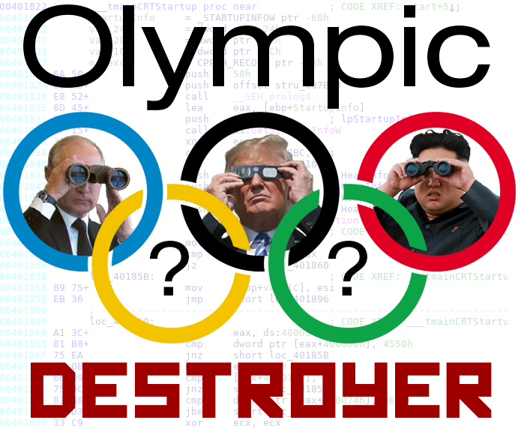
Notes:
**CHANGE TO OLYMPIC BG**
For my final project I chose to do a case study on the Olympic Destroyer Malware
If you’re not familiar it, O D was used in a cyber-attack during the opening ceremonies of the recent Winter Olympic games in South Korea
I felt it was important for two reasons:
1) This attack occurred on the world stage where many nations come together for a peaceful event.
2) contained a lot of interesting artifacts that have been attributed to multiple nation-state actors

Slide 2
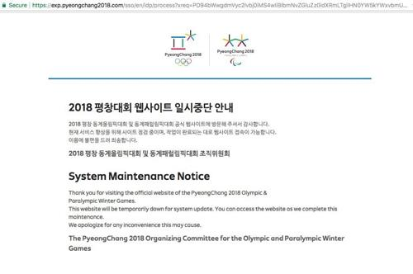
Notes:
2018/02/10 09:13 Local News Agency, Yonhap, Reported the 2018 Olympic Games website was taken offline.
Users were not able to print tickets due to the website being down
Issues with main press center IP television systems
WiFi network within Pyeongchang Olympic Stadium shut off
Subsequent online articles speculated it was a cyber-attack
Malware samples from the attack were located on VirusTotal shortly after

Slide 3
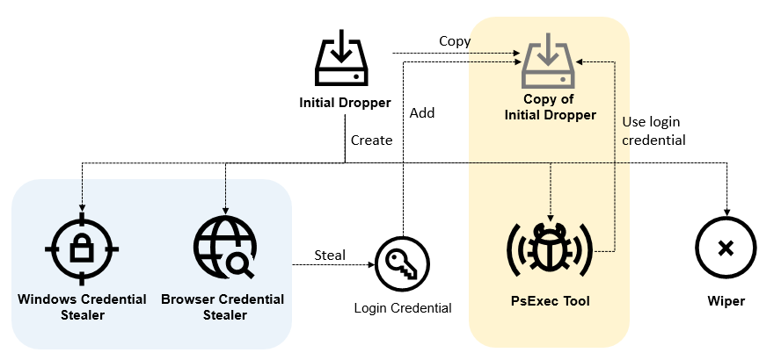
Olympic Destroyer Functionality Overview
Notes:
This malware was labeled Olympic Destroyer by Cisco’s Threat Research team, Talos because it was designed to disable systems at the opening ceremonies
Essentially the malware performed the functions show:
Steal windows credentials
Steal browser credentials
Add new credentials into copied binary
Use PsExec and WMI to pivot within the environment
Use credentials discovered
Wiper component
Deleted system restore and other backups
Disabled OS startup repair
Delete event logs (system and security)
Wipes files on server shares
Disables all services
After 60 minutes Shuts down the system

Slide 4
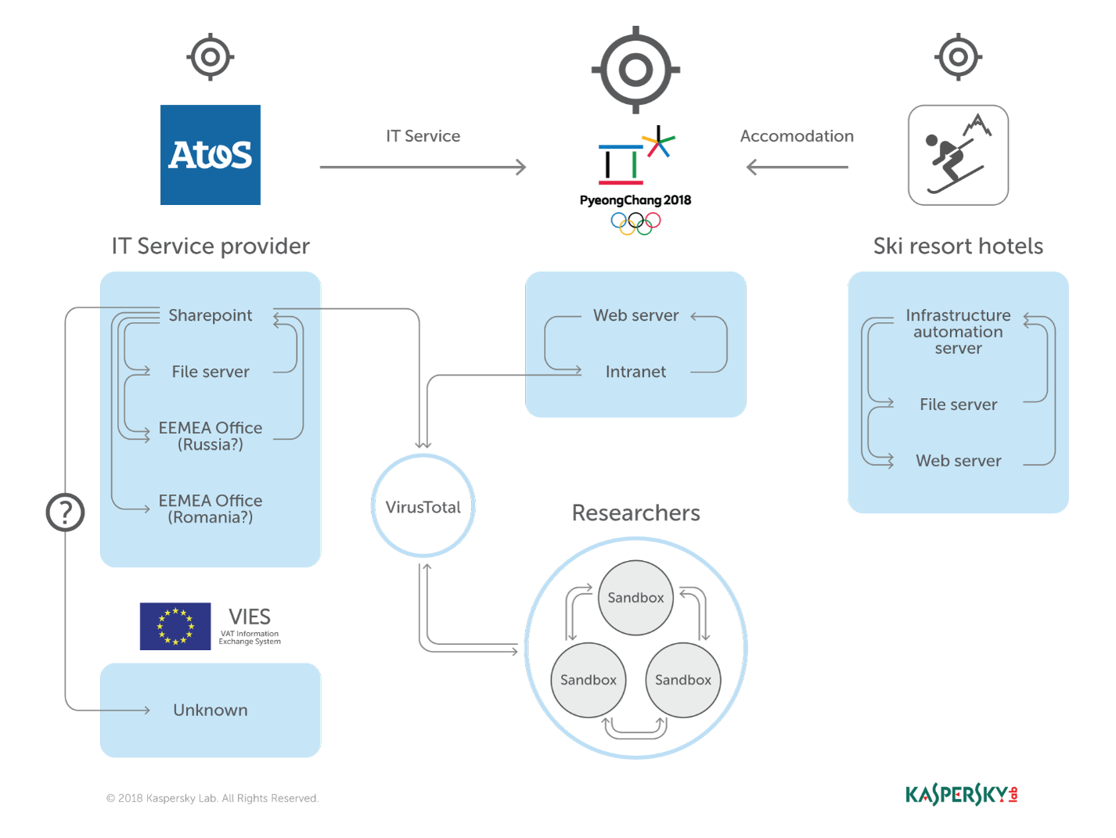

Slide 5
Olympic Destroyer
NotPetya
BadRabbit
mimikatz
PsExec
Lazarus/
BlueNoroff
APT3, APT10
Combine various samples into a single piece of malware
When scaling, group all elements to be scaled. Scale as needed. Use the “Increase Font Size,” “Decrease Font Size” buttons or manually change the font size for the editable text.
Notes:
For the technical details, I focused on reading numerous security vendor blogs on Olympic Destroyer:
Talos points out the similarities to NotPetya and BadRabbit (reset event logs and delete backups) = Russian
Mimikatz to steal credentials, and using PsExec to propagate through networks
Intezer – company that performs malware analysis by comparing similarities in code (expressed in %)
They suggested that the malware was Chinese as it had pieces of 2 known Chinese actors
Recorded Future – Links Olympic destroyer to Malware families used by Lazarus Group = North Korean
Wiper in OD similar to BlueNoroff
Malware author deliberately put different bread crumbs to complicate analysis attribution
Due to the sophistication and complexity, it was very likely a nation-state led attack.

Slide 6
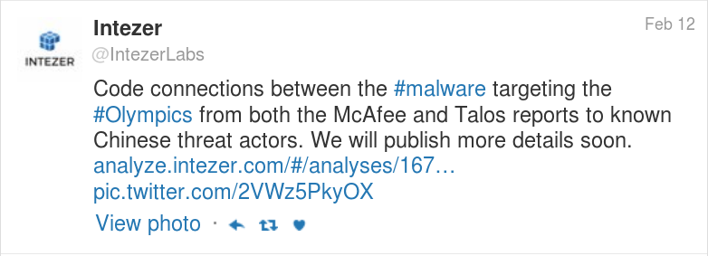

Slide 7
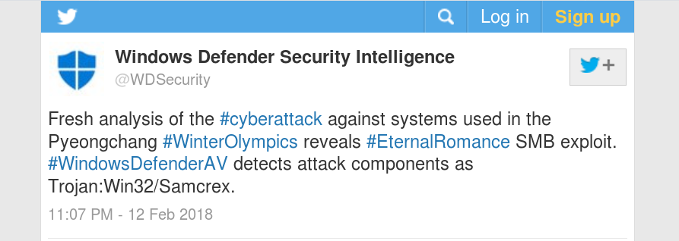

Slide 8
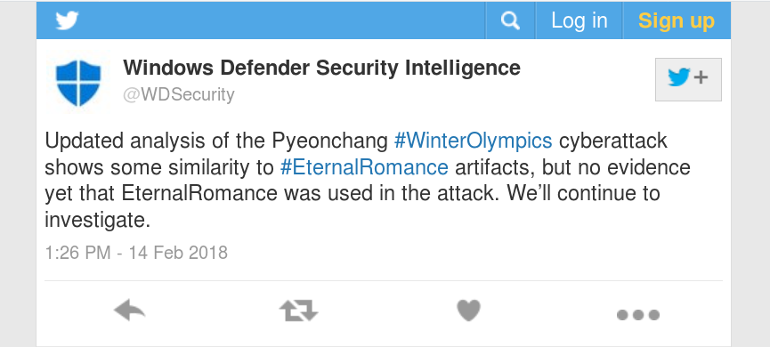

Slide 9

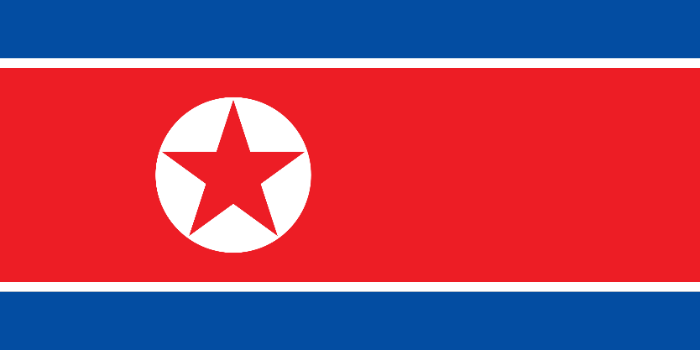

Motives for attack on the Olympics?
China
North Korea
Russia
Notes:
Looking beyond the code, we can try to make an attribution attempt:
**CHANGE TO CHINA BG**
China:
Code similarities identified by Intezer and others are fairly weak
Chinese motives are not as obvious as the other two nation-state actors
APT3 and APT10 espionage type of activities
**CHANGE TO NK BG**
North Korea:
Rival nation they are still at war with is hosting the Olympics
Counter-point - they wanted to participate in Olympics and generally improve their global presence
so doing something like this malware would not be smart
However, There are some strong similarities in O D code that are attributed to Lazarus group

Slide 10

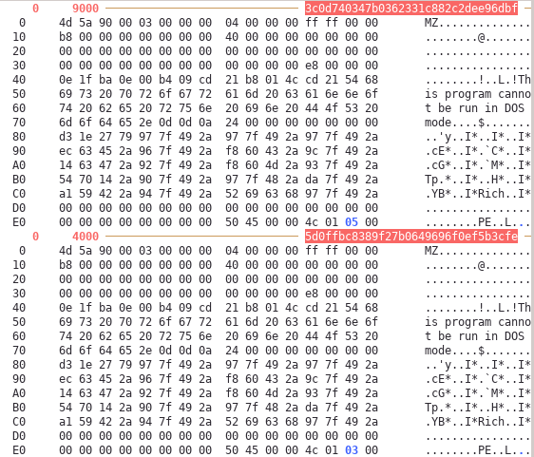
KASPERSKY
Wiper component of Olympic Destroyer contains strong resemblance to Lazarus Group’s BlueNoroff wiper
Metadata - Rich Header in both wiper components are identical
Notes:
Read around 20 different reports on OD, The most thorough analysis came from Kaspersky
They identified it had strong similarities to Lazarus’ BlueNoroff wiper & rich header was identical
Rich Header : Undocumented structure (infrequently used in attribution)
It contains visual studio toolset binary build information
If they are identical, it would mean they were built using the same environment
BlueNoroff, and other North Korean malware samples - developed using Visual Studio 6

Slide 11
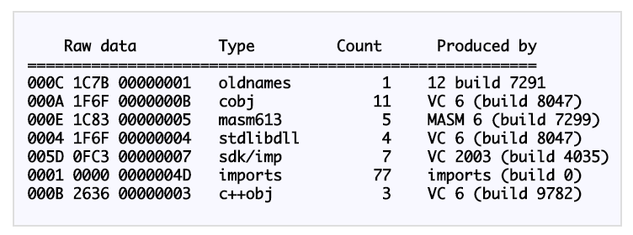
KASPERSKY
“A quick visual inspection of the file shows something very unusual for a file created with Visual Studio 6: references to ‘mscoree.dll’ that did not exist at the time.”
Notes:
Decoded looks like this
Performed experimentation on generating binaries and determined it was actually created in Visual Studio 2010
Threat Actor deliberately copied in the Rich header from the BlueNoroff sample
This evidence is the most convincing that the O D malware was a false-flag operation trying to frame North Korea
There is an additional sample Kaspersky located on VT that the actor used where they forgot to swap out the Rich header

Slide 12
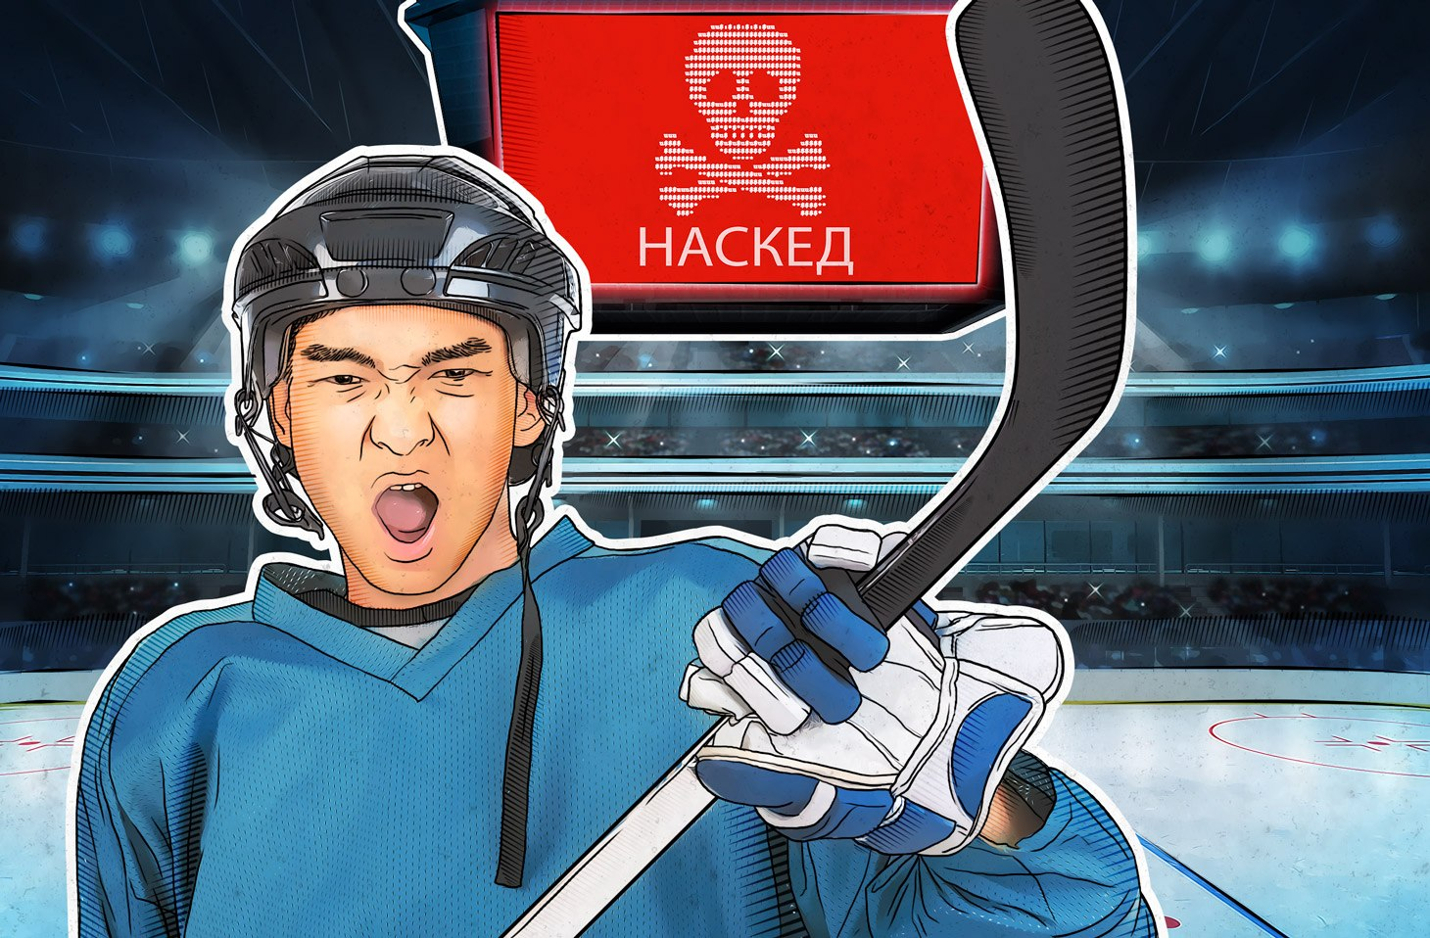
Помимо всего прочего, в процессе изучения Olympic Destroyer наши эксперты обнаружили ряд улик, указывающих на совсем другого автора — русскоязычную хакерскую группировку Sofacy (также известную как APT28 и Fancy Bear).
Notes:
I thought researching Kaspersky’s Russian webpage regarding the same incident (if it even existed) would have different information regarding the threat actor:
In regard to North Korea, they stated:
Among other things, in the process of studying Olympic Destroyer, our experts discovered a number of [pieces of] evidence pointing to a very different author - the Russian-speaking hacker group Sofacy (also known as APT28 and Fancy Bear).
However, we can not exclude the possibility that these clues, in turn, are also counterfeit. When it comes to cyber espionage "at the highest level," you can not be 100% sure of anything.

Slide 13
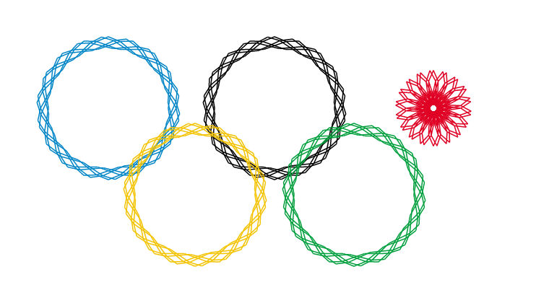
Russian Motive?
Notes:
*CHANGE BG TO RUSSIA**
Sochi 2014 doping scandal, banned from Olympics
International Olympic Committee (IOC) announced Russia’s ban from Olympics in Dec 2017
Olympic targeted Phishing Campaigns occur shortly afterward targeting official sponsors of the Olympic games and the IOC
Various threat intelligence sources reportedly linked these activities to Russian APT28 (FireEye) or Fancy Bear (CrowdStrike)
As JM has pointed out in this class a few times, attribution is HARD
I would argue And it will continue to become increasingly more difficult
Because of code reuse, mimicking TTPs for false-flag operations
Samples such as O D demonstrate how important it is to examine “beyond the code”
Other non-technical lenses like political international landscape
Why wasn’t the world cup hacked in the same way?

Slide 14
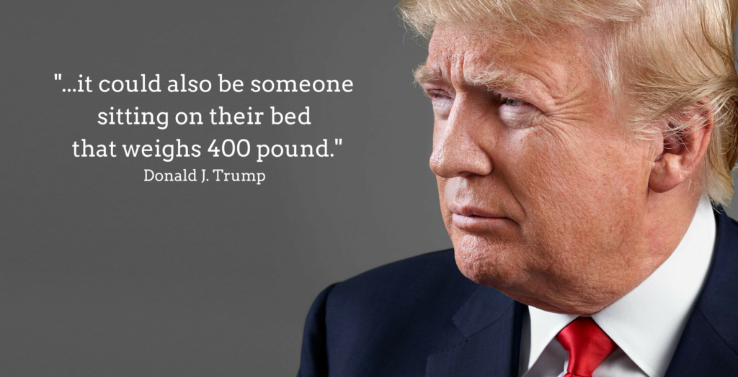

Slide 15
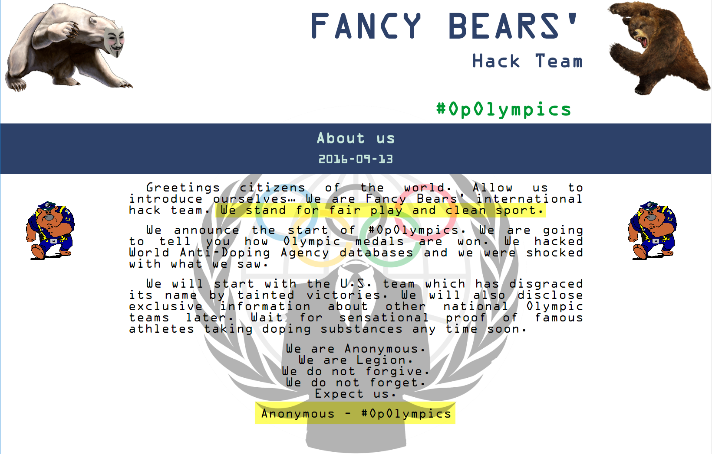

Slide 16
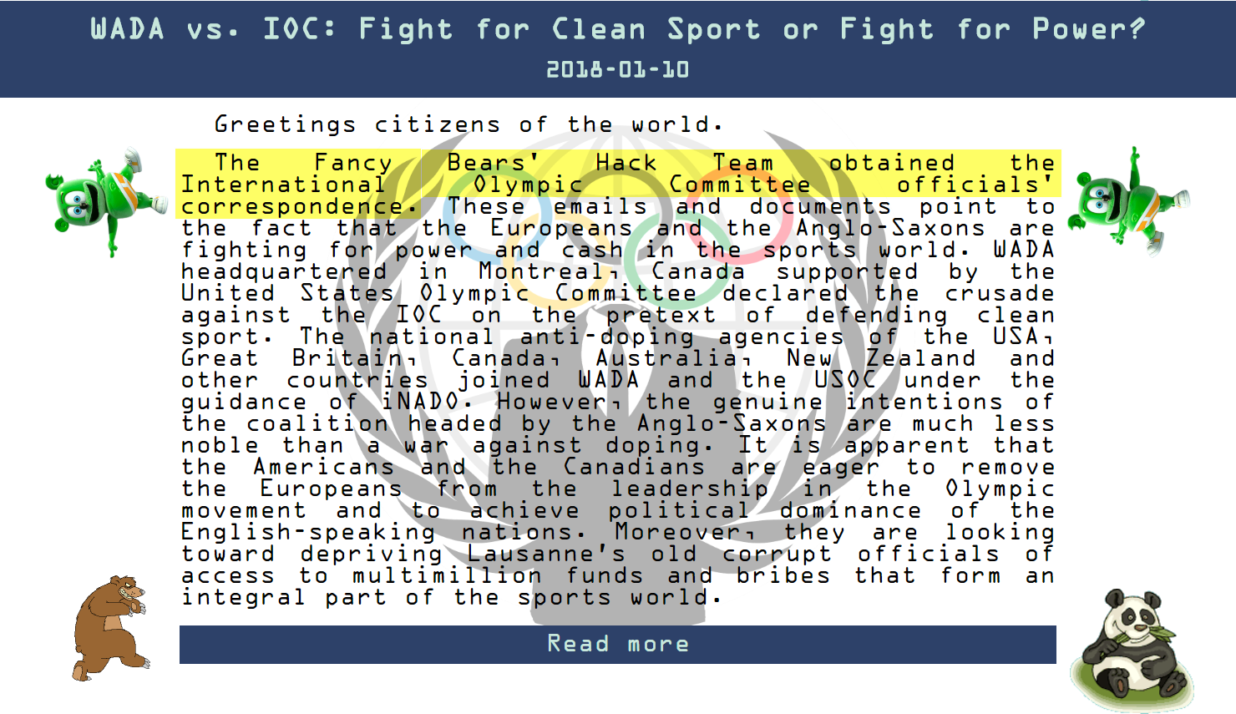
Notes:
In January 2018, Fancy Bears Hack Team has claimed to have hacked the International Olympic Committee Officials’ correspondence.

